Slide 1
Principles of Next Generation Sequencing

Slide 2
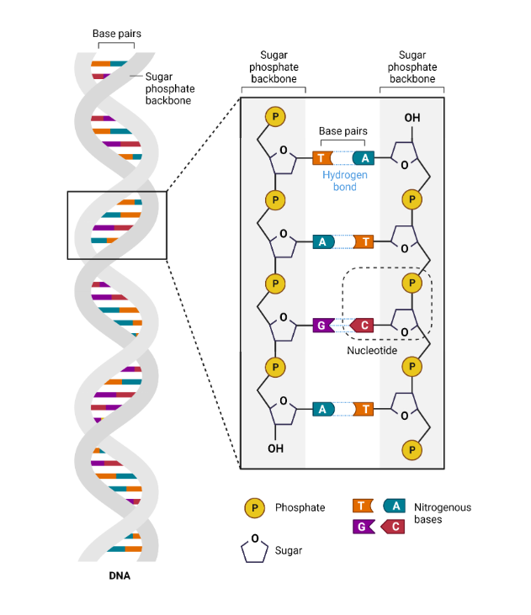
What is NGS?
Sequencing is the process of determining the order of the four bases that make up the DNA molecule
NGS is a term for sequencing technologies that enable the sequencing of many DNA strands at the same time.
“massive-parallel sequencing”

Slide 3
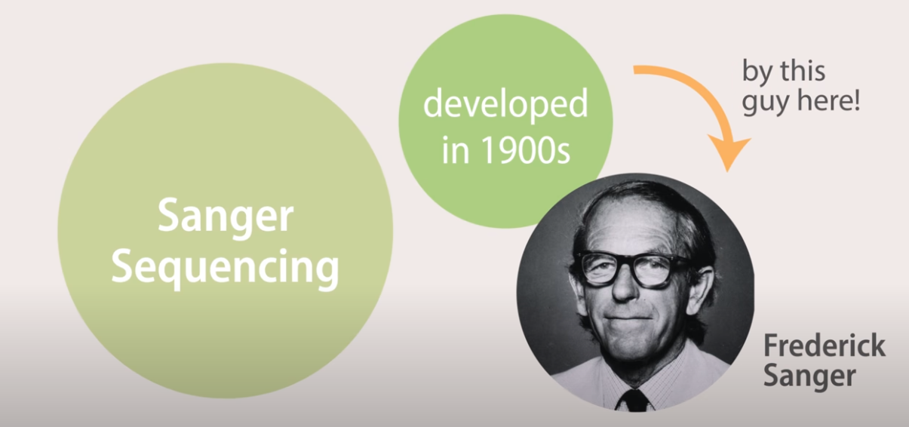

Slide 4
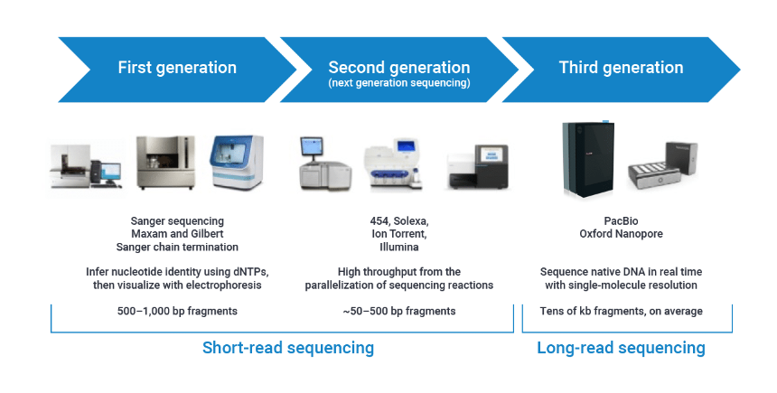

Slide 5
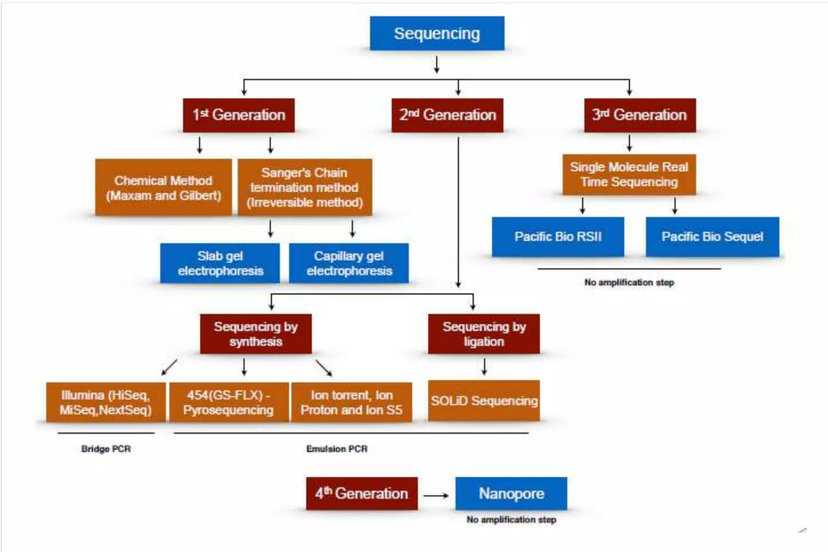

Slide 7
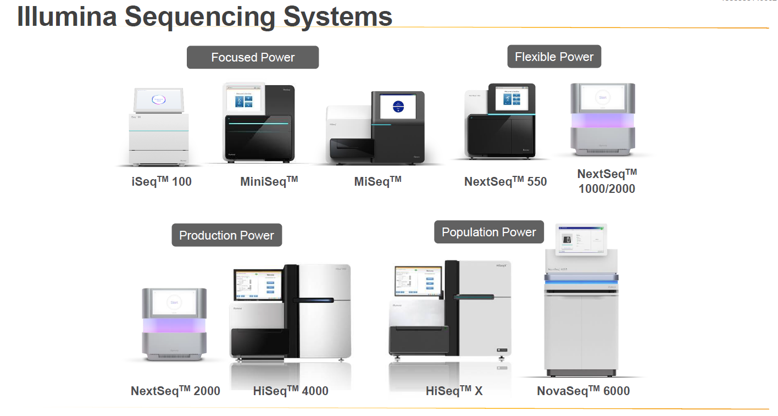

Slide 8
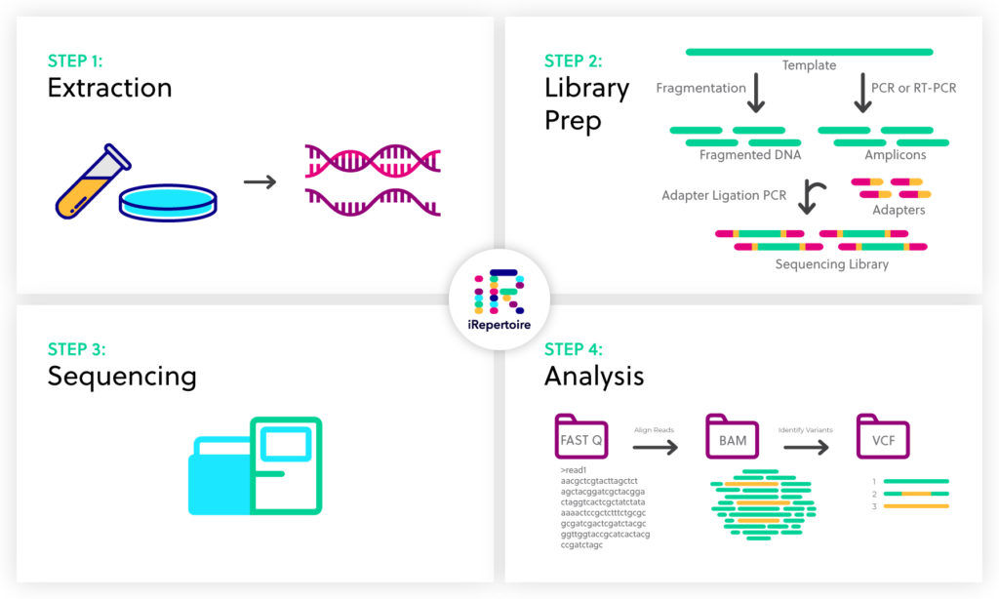

Slide 9
Sequencing libraries
Sequencing libraries are DNA fragments that either contain genomic DNA or complementary DNA
Genomic DNA library
Contains the complete set of genetic material of an organism.
DNA is extracted from the cell nucleus
Complementary DNA (cDNA) library
Contains the total mRNA expressed in tissues.
mRNA is extracted and converted to cDNA using reverse transcription enzymes.
Enriched regions of the genome
PCR amplicon product

Slide 10
Sequencing
Sequencing
Cluster generation
Sequencing by synthesis

Slide 11
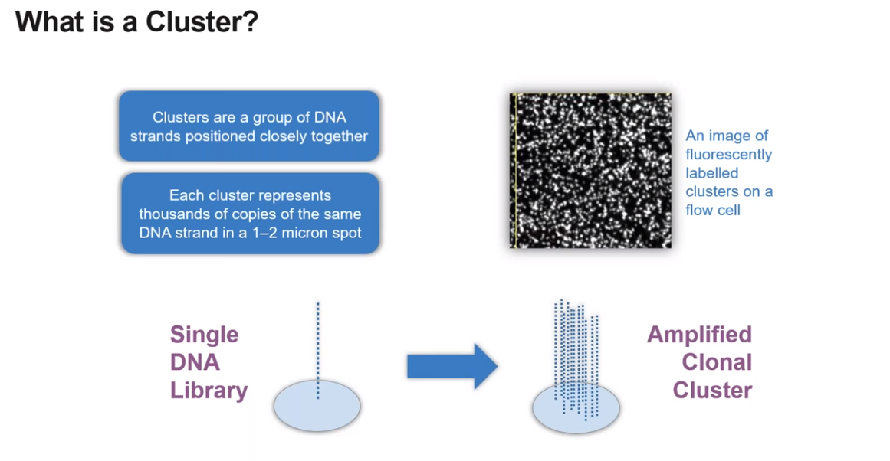


Slide 12
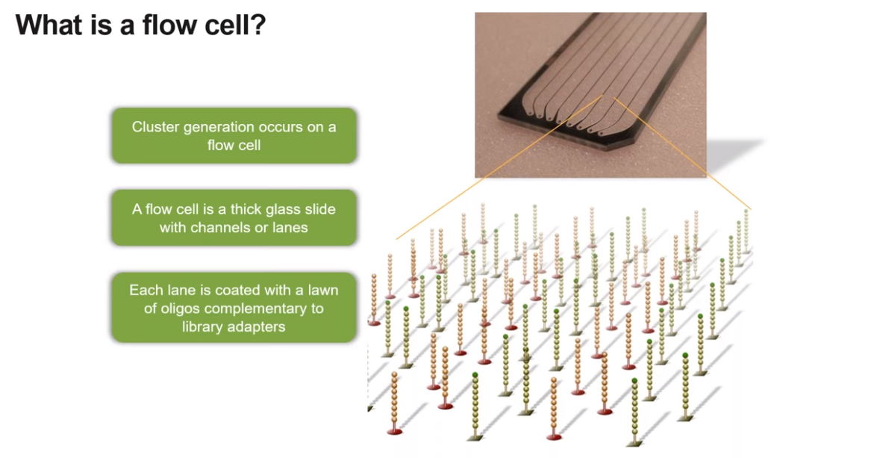

Slide 13
Cluster generation

Slide 14
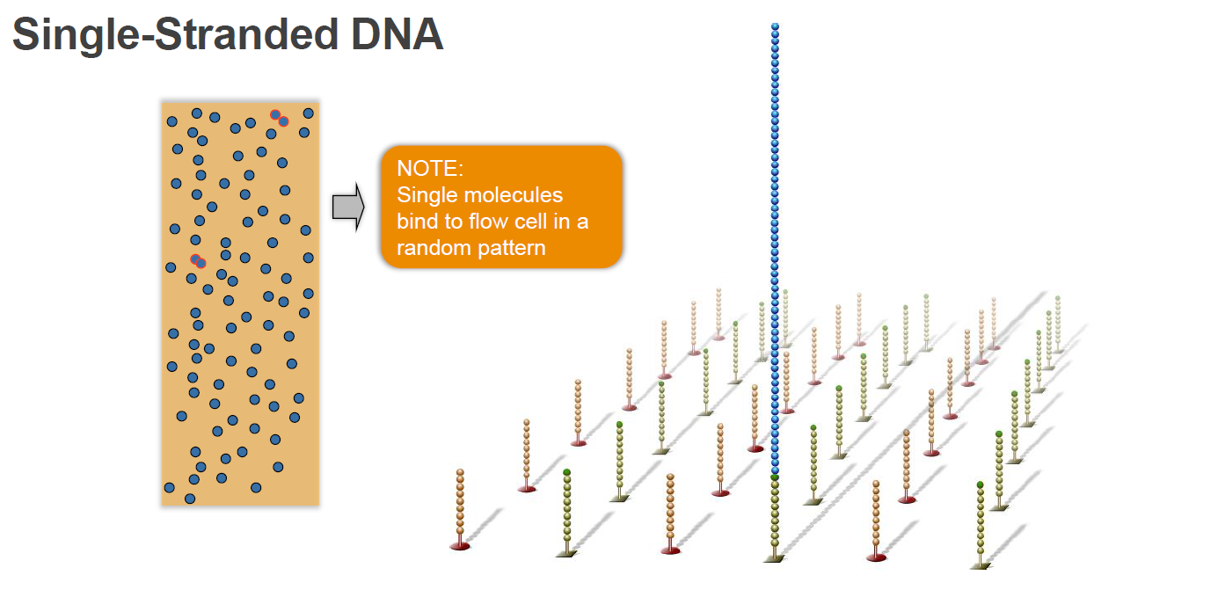
Cluster generation

Slide 15
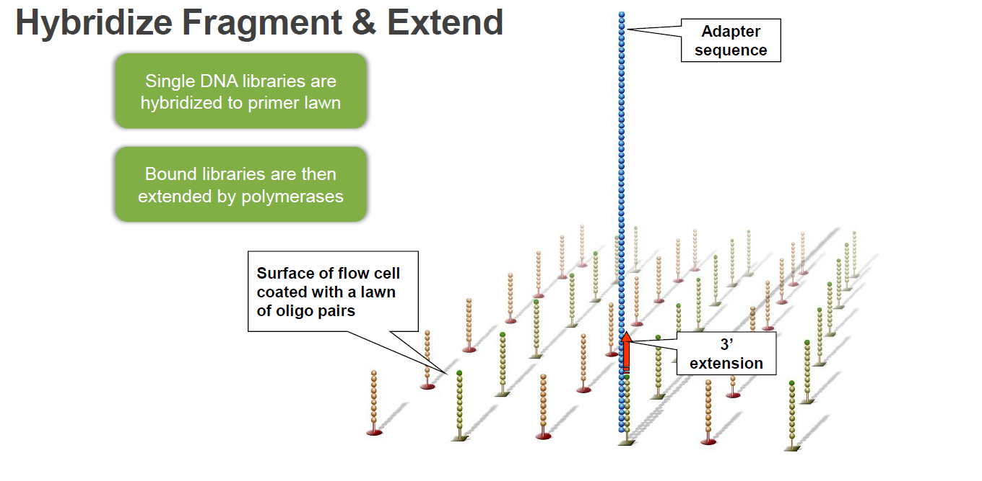
Cluster generation

Slide 16
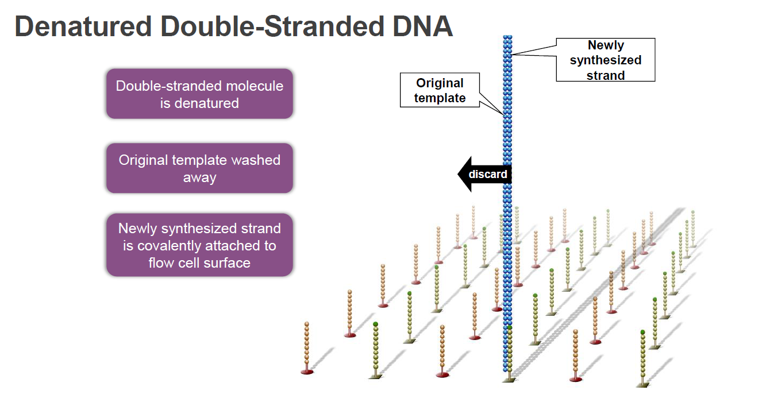
Cluster generation

Slide 17
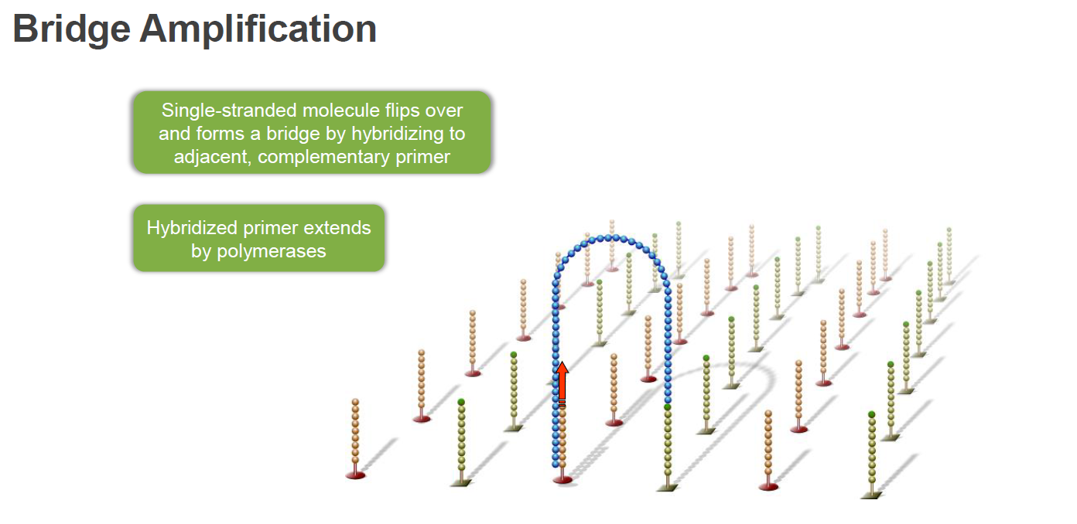
Cluster generation

Slide 18
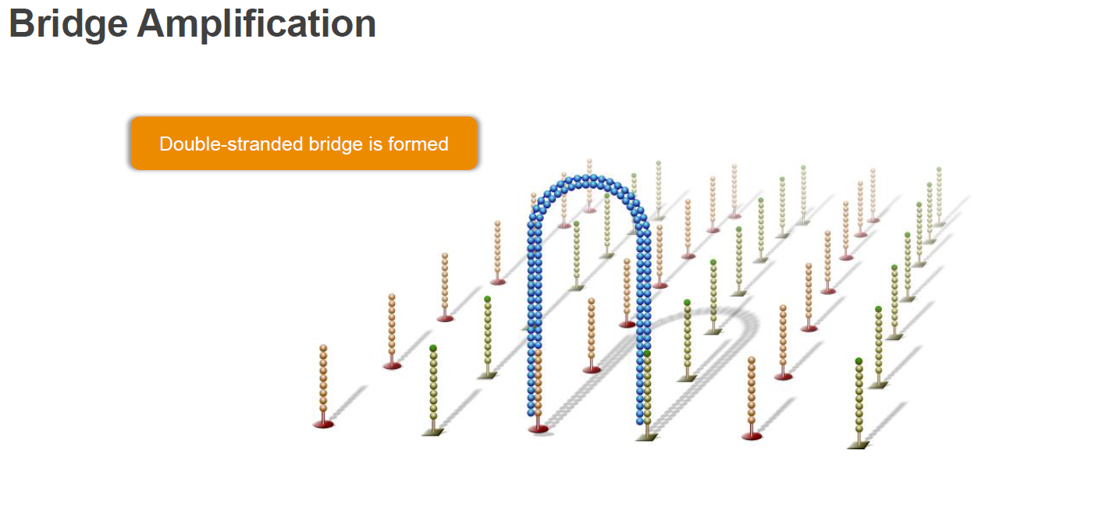
Cluster generation

Slide 19
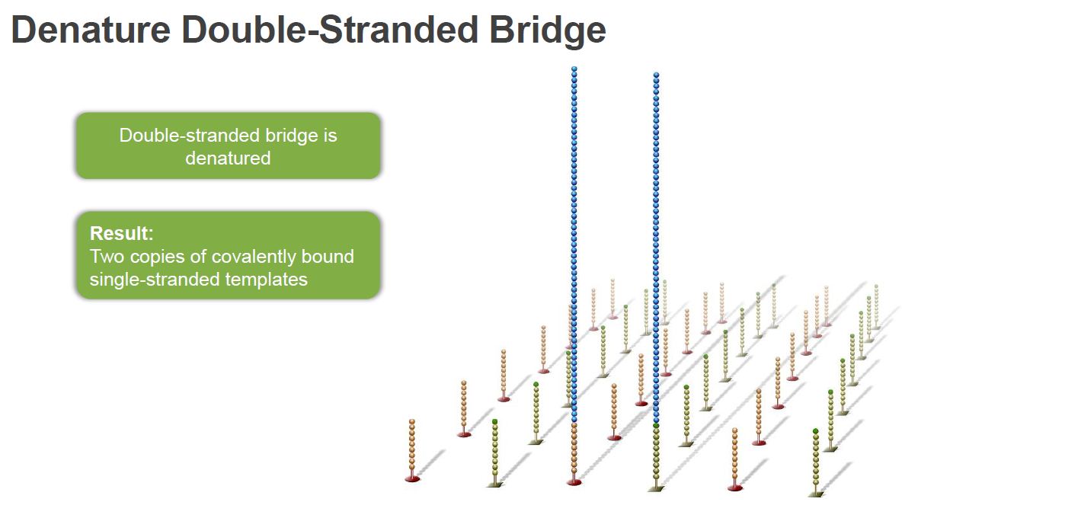
Cluster generation

Slide 20
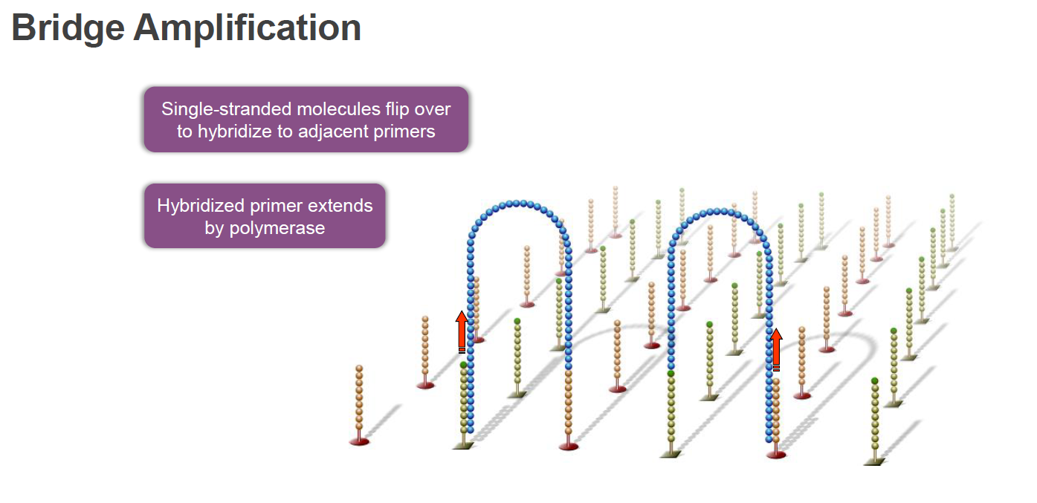
Cluster generation

Slide 21
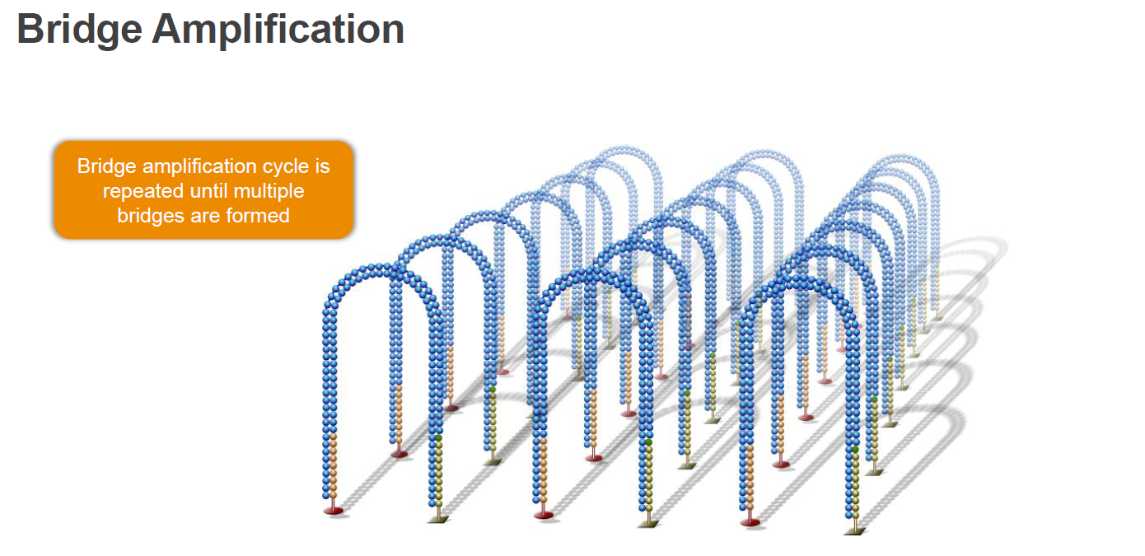
Cluster generation

Slide 22
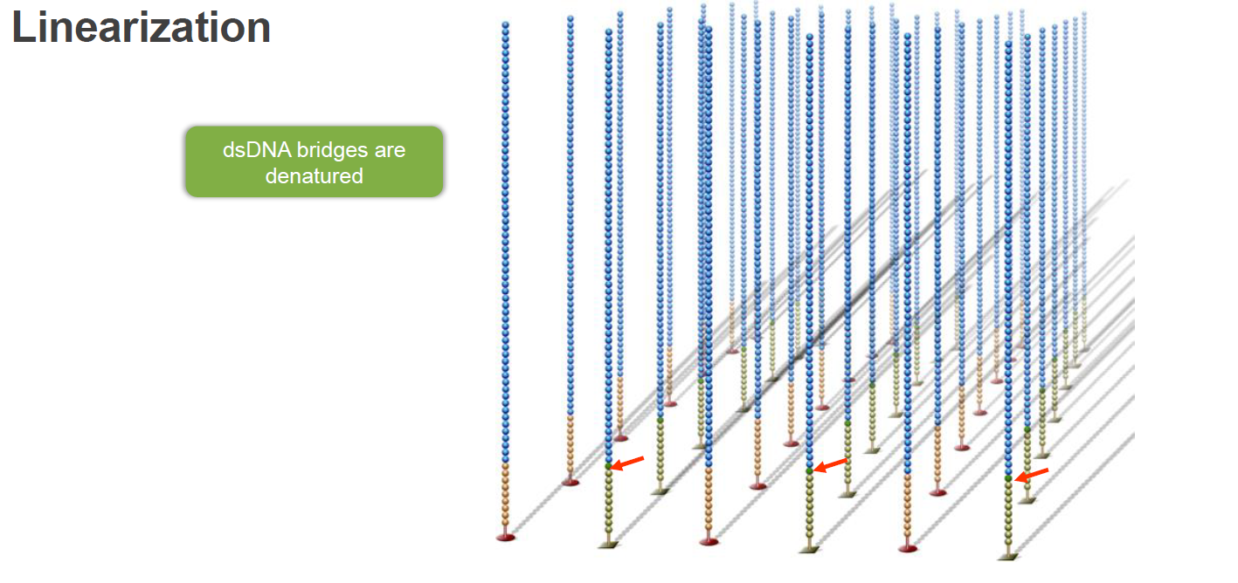
Cluster generation

Slide 23
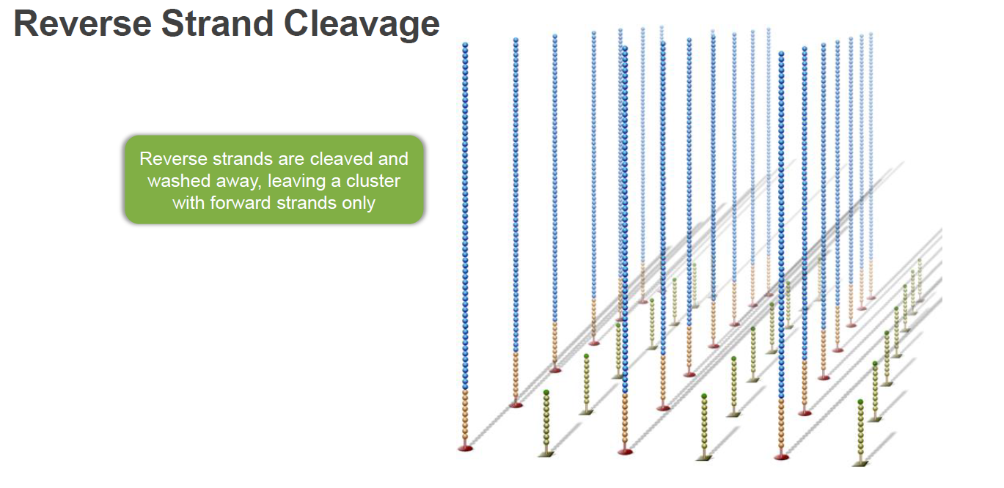
Cluster generation

Slide 24
Sequencing
by
synthesis

Slide 25
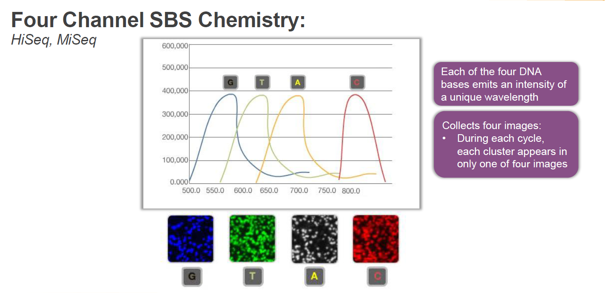
Sequencing by synthesis

Slide 26
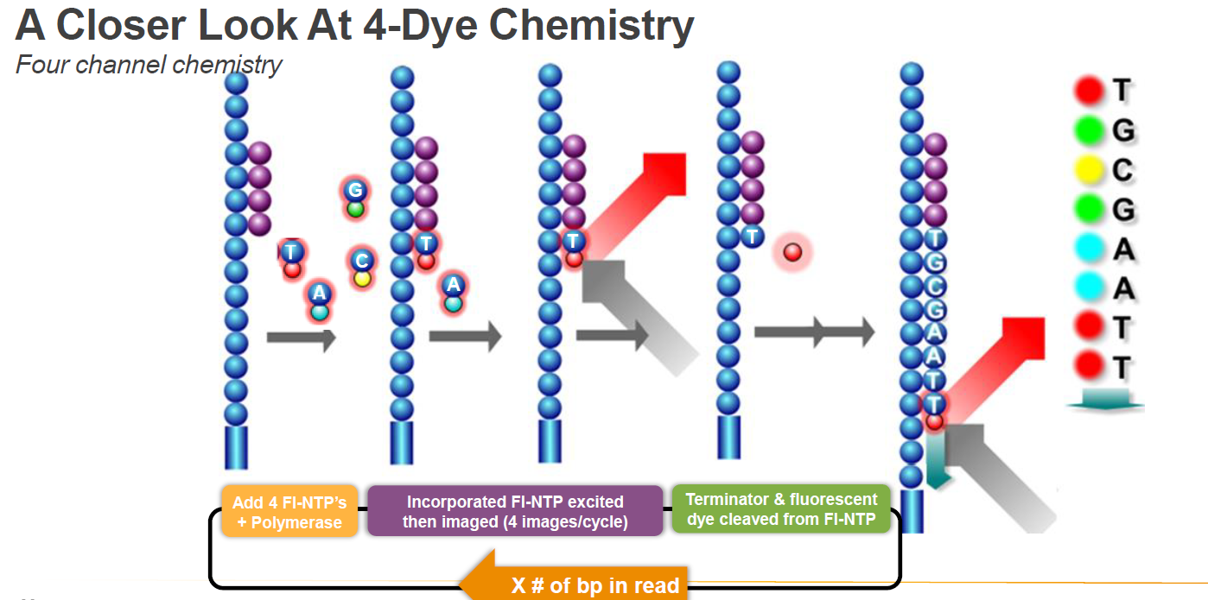
Sequencing by synthesis

Slide 27
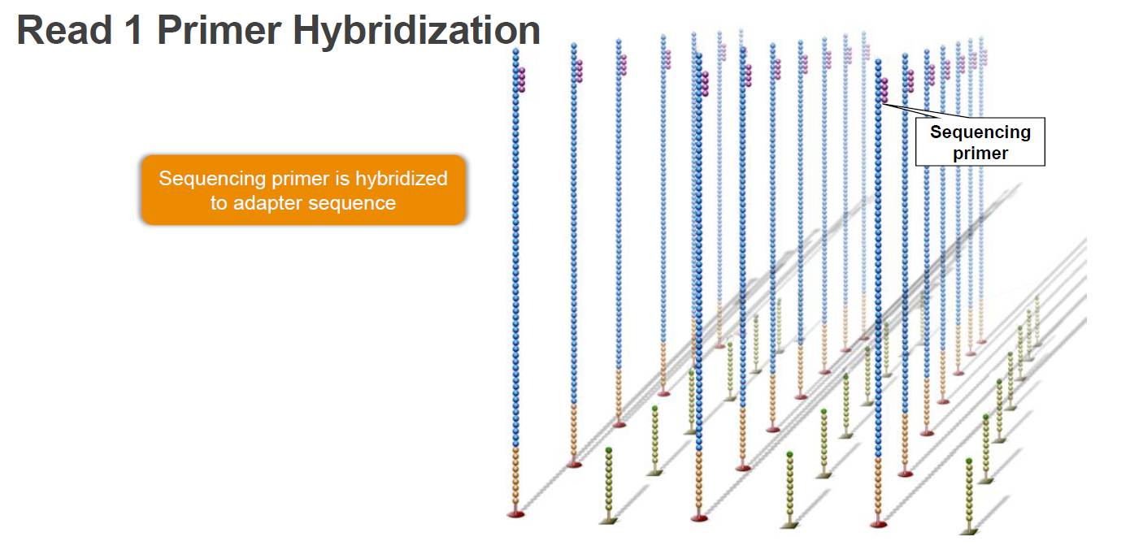
Cluster generation

Slide 28
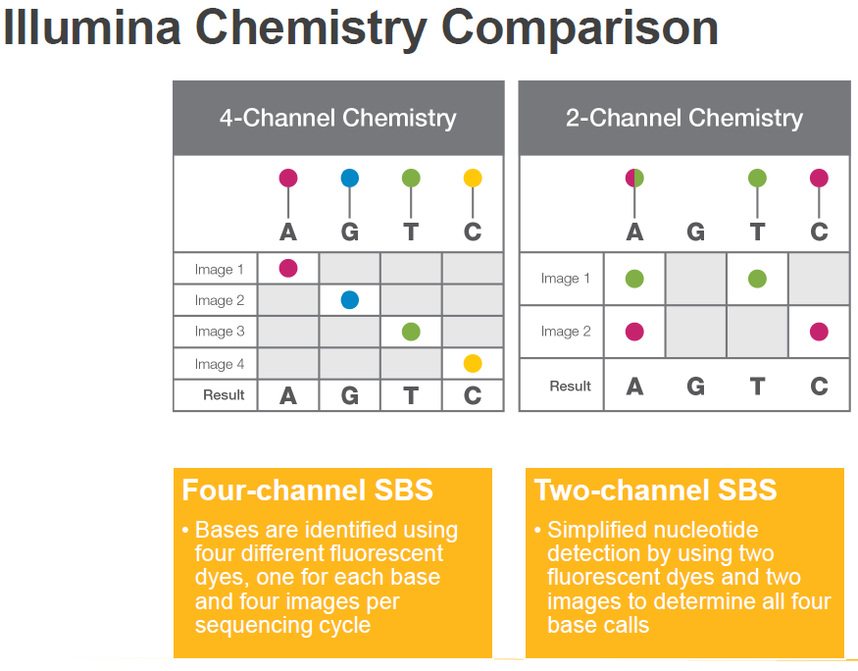

Slide 29
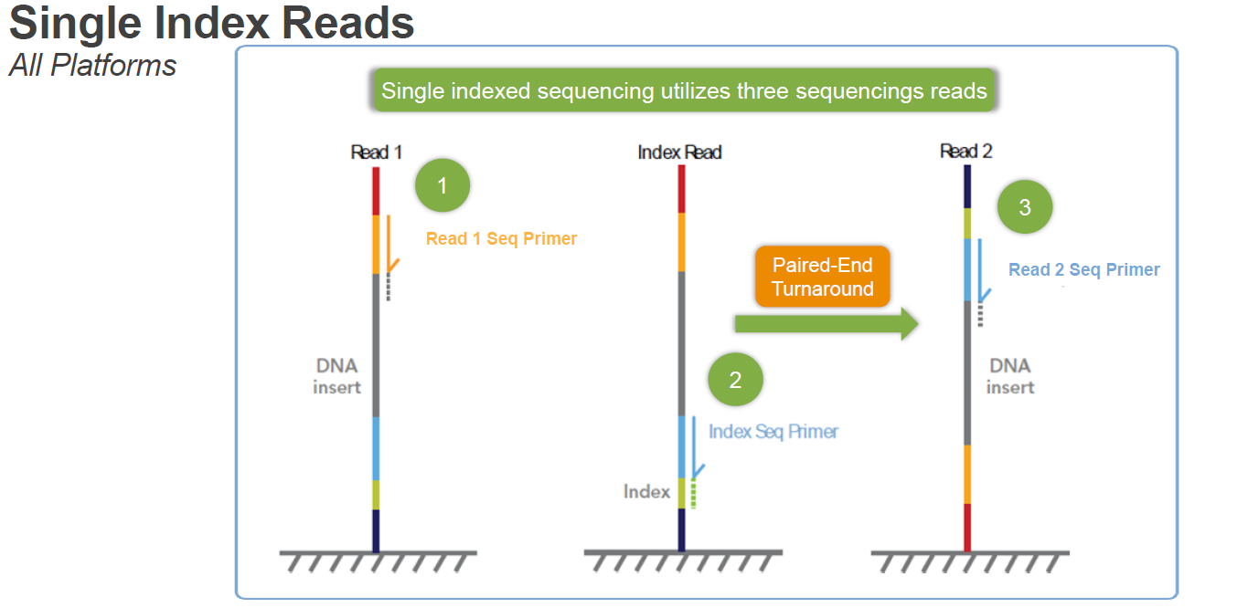

Slide 30
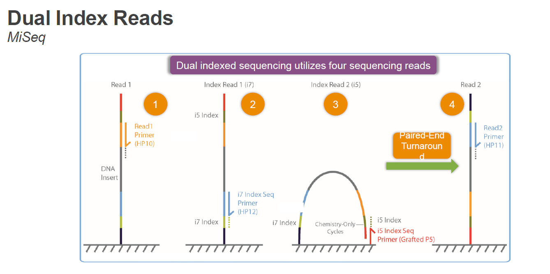

Slide 32
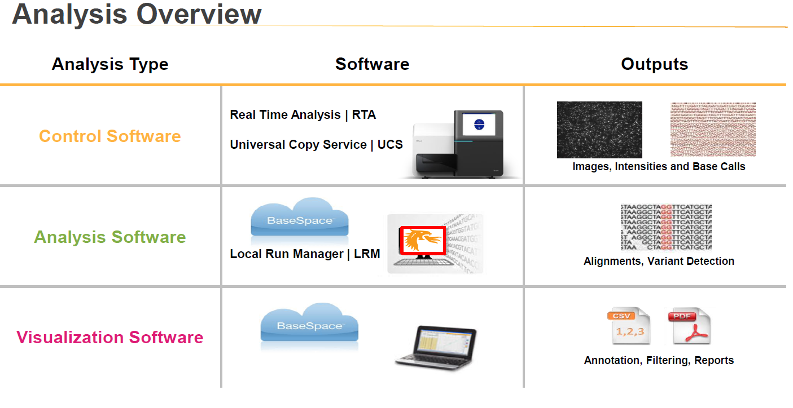

Slide 33
Video
https://youtu.be/fCd6B5HRaZ8

Slide 34






